Slide 1
Dual epidemics: the impact of HIV and obesity on pregnancy outcomes among women in South Africa
Angela Bengtson, PhD
Stanzi M le Roux, Tamsin K Phillips, Kirsty Brittain, Allison Buba, Elaine J. Abrams, Landon Myer
@BengtsonAngie
Share your thoughts on this presentation with #IAS2019

Slide 2
No conflicts to declare.

Slide 3
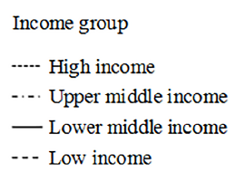
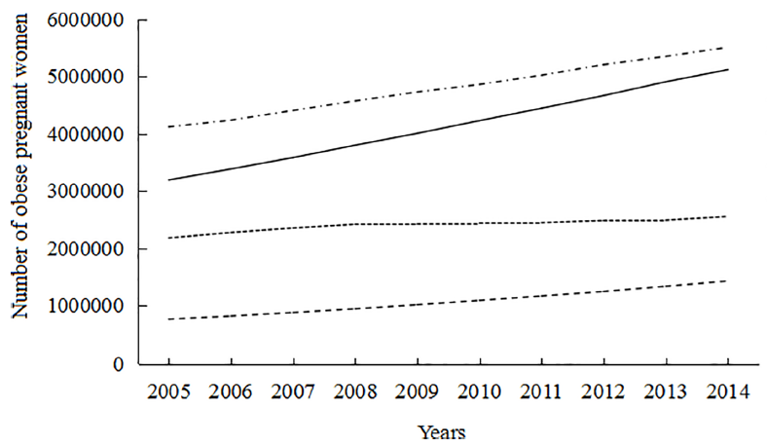
Obesity during pregnancy is increasing in low and middle income countries
Number of obese pregnant women (BMI>30) by
WHO region from 2005 to 2014.
12 million obese pregnant women
Figure from: Chen C, Xu X, Yan Y (2018) Estimated global overweight and obesity burden in pregnant women based on panel data model. PLoS ONE 13 (8): e0202183. https://doi.org/10.1371/journal. pone.0202183
Notes:
Globally, obesity during pregnancy is rising. It’s rising fastest in Lower and upper middle income countries, where there are an estimated 12 million obese pregnant women.

Slide 4
Obesity during pregnancy
Hypertension
Pre-eclampsia
Gestational diabetes
Stillbirth
Cesarean delivery
Large for gestational age
Notes:
Add in citations

Slide 5
Obesity during pregnancy
Hypertension
Pre-eclampsia
Gestational diabetes
Stillbirth
Cesarean delivery
Large for gestational age
HIV and ART during pregnancy
cardio-metabolic
DTG : weight gain
Preterm birth
Small for gestational age
Low birthweight
Notes:
Obesity during pregnancy may be a particular concern for HIV-infected women on ART.
Some types of ART linked to increased risk of diabetes and CVD
DTG and weight gain
But the cardio metabolic impact of ART in pregnancy is not well defined
,
What is well known is that HIV and ART are already at high risk for several adverse pregnancy outcomes

Slide 6
Obesity during pregnancy
Hypertension
Pre-eclampsia
Gestational diabetes
Stillbirth
Cesarean delivery
Large for gestational age
HIV and ART during pregnancy
cardio-metabolic
DTG : weight gain
Preterm birth
Small for gestational age
Low birthweight
?
What is the dual impact of obesity and HIV
on pregnancy outcomes?
Notes:
As obesity during pregnancy is rising and more women living with HIV are entering pregnancy on ART, there is a need to understand the dual impact of HIV and obesity on pregnancy outcomes.

Slide 7
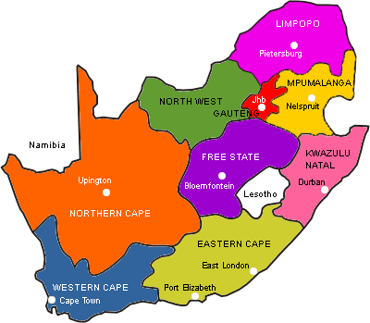
South Africa: high dual burden of HIV and obesity
Setting: Guguletu, South Africa
30% of pregnant women living with HIV
40% of pregnant women obese
Design: secondary analysis of the MCH-ART trial (HIV+) and HU2 (HIV-) comparator cohort
Notes:
MCH Trial evaluating integrating postpartum services into ART care.
Study occurred at a ministry of health support maternity center in Guguletu, a township outside of Cape Town South Africa. postpartum:

Slide 8
Study population
Singleton, live births (n=877)
464 women living without HIV
413 women living with HIV
Tenofovir + emtricitabine/ lamivudine + efavirenz
96% initiating ART during index pregnancy
Women enrolled at entry into antenatal care
Followed through 12 months postpartum
Notes:
– enrollment at entry into ANC.
-GA dated using ultrasound
-trained research assistants did anthropometry measurements

Slide 9
Do associations between pre-pregnancy BMI and pregnancy outcomes differ by HIV status?
Birth
weight
Preterm birth
<37 weeks
LGA
>90th percentile
Cesarean section
Pre-pregnancy
Body Mass Index (BMI)
Normal (18.5 - <25; reference)
Underweight (<18.5)
Overweight (25 - <30)
Obese (≥ 30)
LBW
<2500 grams
SGA
<10th percentile
Notes:
Mention that all results reported are preliminary

Slide 10
Do associations between pre-pregnancy BMI and pregnancy outcomes differ by HIV status?
Birth
weight
Preterm birth
LGA
Cesarean section
Pre-pregnancy
Body Mass Index (BMI)
LBW
Examined associations:
Overall
Among HIV-uninfected
Among HIV-infected
SGA

Slide 11
Do associations between pre-pregnancy BMI and pregnancy outcomes differ by HIV status?
Adjusted for:
Socio-economic
Poverty
Maternal age
Gravidity
Alcohol use
Education
HIV status (overall only)
Birth
weight
Preterm birth
LGA
Cesarean section
Pre-pregnancy
Body Mass Index (BMI)
LBW
SGA

Slide 12
Results
Age: median 28 (IQR 24, 32)
Gestational age at entry into ANC : median 20 weeks (IQR 14, 26)
Pregnant for the first time: 22%
Comorbidities at entry into ANC:
7% HIV-uninfected vs 25% HIV-infected hazardous alcohol use
22% HIV-uninfected vs 33% HIV-infected stage 1 or 2 hypertension
Notes:
Based on the AUDIT-C (range 0-12); a score of ≥3 indicates hazardous drinking.
Blood pressure categorized as: normal (< 120/80 mm Hg), elevated (systolic 120–129 and diastolic <80 mm Hg), or stage 1 high (systolic 130–139 or diastolic 80–89 mm Hg) or stage 2 hypertension (systolic > 140 or diastolic > 90 mm Hg).

Slide 13
Results
Pre-Pregnancy BMI

Slide 14
Results
Pre-Pregnancy BMI

Slide 15
Pregnancy outcomes by HIV status
 | HIV-uninfected |  | HIV-infected |  | Overall
 | N=413 |  | N=464 |  | N=877
Pregnancy Outcome | N (%)*
Cesarean delivery | 156 (37.8) |  | 141 (30.4) |  | 297 (33.9)
Preterm birth | 39 (9.4) |  | 54 (11.6) |  | 93 (10.6)
LBW | 37 (9.0) |  | 58 (12.5) |  | 95 (10.8)
Small for gestational age (SGA) | 45 (10.9) |  | 55 (11.8) |  | 100 (11.4)
Large for gestational age (LGA ) | 67 (16.2) |  | 28 (6.0) |  | 95 (10.8)
Birthweight, g (median, IQR) | 3220 (2850, 3500) |  | 3150 (2765, 3400) |  | 3180 (2820, 3460)
*unless otherwise noted.
Notes:
Numbers confirmed.
Take out birthweight?

Slide 16
Pregnancy outcomes by HIV status
Women living with HIV had a fewer cesarean sections and LGA infants
 | HIV-uninfected |  | HIV-infected |  | Overall
 | N=413 |  | N=464 |  | N=877
Pregnancy Outcome | N (%)*
Cesarean delivery | 156 (37.8) |  | 141 (30.4) |  | 297 (33.9)
Preterm birth | 39 (9.4) |  | 54 (11.6) |  | 93 (10.6)
LBW | 37 (9.0) |  | 58 (12.5) |  | 95 (10.8)
SGA | 45 (10.9) |  | 55 (11.8) |  | 100 (11.4)
LGA | 67 (16.2) |  | 28 (6.0) |  | 95 (10.8)
Birthweight, g (median, IQR) | 3220 (2850, 3500) |  | 3150 (2765, 3400) |  | 3180 (2820, 3460)
*unless otherwise noted.

Slide 17
Pregnancy outcomes by HIV status
Women living with HIV had a more preterm and LBW infants
 | HIV-uninfected |  | HIV-infected |  | Overall
 | N=413 |  | N=464 |  | N=877
Pregnancy Outcome | N (%)*
Cesarean delivery | 156 (37.8) |  | 141 (30.4) |  | 297 (33.9)
Preterm birth | 39 (9.4) |  | 54 (11.6) |  | 93 (10.6)
LBW | 37 (9.0) |  | 58 (12.5) |  | 95 (10.8)
SGA | 45 (10.9) |  | 55 (11.8) |  | 100 (11.4)
LGA | 67 (16.2) |  | 28 (6.0) |  | 95 (10.8)
Birthweight, g (median, IQR) | 3220 (2850, 3500) |  | 3150 (2765, 3400) |  | 3180 (2820, 3460)
*unless otherwise noted.

Slide 18
Associations between pre-pregnancy BMI category and pregnancy outcomes
Birth
weight
Preterm birth
LGA
Cesarean section
LBW
SGA
Notes:
Numbers confirmed

Slide 19
Associations between pre-pregnancy BMI category and pregnancy outcomes
Birth
weight
Preterm birth
LGA
Cesarean section
Obesity associated with cesarean delivery.
Overall: RR 1.69 (95% CI 1.29, 2.22)
HIV-negative: RR 1.65 (95% CI 1.15, 2.38)
HIV-infected: RR 1.70 (95% CI 1.14, 2.54)
LBW
SGA
Notes:
Numbers confirmed
Obese women were more likely to have a cesarean delivery

Slide 20
Birth
weight
Preterm birth
LGA
Cesarean section
No associations between any BMI category and preterm birth.
Overall or by HIV status.
LBW
SGA
Notes:
Numbers confirmed
Slight trend in underweight women being more likely to have a preterm birth, but CI included null value of 1. 0

Slide 21
Birthweight increased with increasing pre-pregnancy BMI.
Overall: Mean 11.36 (95% CI 5.96, 16.76)
HIV-negative: Mean 11.81 (95% CI 4.11, 19.52)
HIV-infected: Mean 9.92 (95% CI 2.16, 17.68)
Birth
weight
Preterm birth
LGA
Cesarean section
LBW
SGA
Notes:
Numbers confirmed

Slide 22
Trend towards women with higher BMI being less likely to have a LBW.
LBW
HIV-uninfected
HIV-infected
Preterm Birth
Associations between pre-pregnancy BMI category and low birthweight.
Effect estimates adjusted for: SES category, poverty category, maternal age (restricted cubic spline), gravidity (restricted cubic spline), AUDIT-C threshold, education.
Notes:
Numbers confirmed
No evidence of an association overall or by HIV status, but in general, women with higher BMI were less likely to have a LBW,
Except for obese HIV-uninfected women, who were somewhat more likely to have an SGA - likely driven by small numbers (n=12 obese HIV-negative women with a LBW).

Slide 23
Obese HIV-uninfected women more likely to have a LGA infant, but not HIV-infected women.
LGA
HIV-uninfected
HIV-infected
Associations between pre-pregnancy BMI category and large for gestational age.
Effect estimates adjusted for: SES category, poverty category, maternal age (restricted cubic spline), gravidity (restricted cubic spline), AUDIT-C threshold, education.
Notes:
Numbers confirmed
No underweight HIV-uninfected women who had a LGA baby
Looking at LGA, we start to see some potential differences by HIV infections status. As we would expect, obese HIV-uninfected women were more likely to have an LGA infant. This isn’t true for HIV-infected women. In fact obesity, looks to be somewhat protective for HIV-infected women. Likely due to there only being 8 obese HIV-infected women who had an LGA infant. And most LGAs happening among normal weight women.
Only 28 LGA infants overall among HIV-infected women.

Slide 24
Underweight HIV-uninfected women more likely to have a SGA infant, but not HIV-infected women.
HIV-uninfected
HIV-infected
SGA
Associations between pre-pregnancy BMI category and small for gestational age.
Effect estimates adjusted for: SES category, poverty category, maternal age (restricted cubic spline), gravidity (restricted cubic spline), AUDIT-C threshold, education.
Notes:
Numbers confirmed
Similarly, HIV-uninfected underweight women are more likely to have an SGA infant. Also not true for HIV-infected women.

Slide 25
Proportion of women in each pre-pregnancy BMI category, among all women with each adverse pregnancy outcome

Slide 26
Proportion of women in each pre-pregnancy BMI category, among all women with each adverse pregnancy outcome
Normal
Obese
Notes:
For HIV-infected women: with the exception of cesarean section, a higher proportion of adverse outcomes happen among normal weight women
For HIV-uninfected women: highest proportion of adverse outcomes is among obese women

Slide 27
Key Findings
In a cohort of pregnant women living with and without HIV, obesity was common.
45% of HIV-uninfected
36% of HIV-infected
Among women with adverse pregnancy outcomes, largest proportion:
HIV-uninfected → obese weight
HIV-infected → normal weight
Cesarean section
LBW
SGA

Slide 28
Key Findings
No evidence of an association between pre-pregnancy BMI category and
preterm birth or LBW.
Obesity was associated with LGA and underweight with SGA, among
women living without HIV.
But not among women living with HIV.
Cesarean section
LBW
SGA

Slide 29
Limitations and Next Steps
Limitations
Estimate of pre-pregnancy BMI based on BMI at first ANC
No information: pregnancy complications, gestational weight gain, indication for cesarean delivery
Limited precision for stratified estimates
Next steps
Prospective cohort: HIV and ART use on hypertension and gestational diabetes
Ideally, after DTG rollout in South Africa
Notes:
Estimation of pre-pregnancy weight/BMI reference: Santos et al, 2018. BMC Medicine. Gestational weight gain charts for different
body mass index groups for women in Europe, North America, and Oceania. 39 cohorts included through the Maternal Obesity and Childhood Outcomes
(MOCO).

Slide 30
Implications
Obesity during pregnancy is a growing public health concern in LMICs for both women living with and without HIV.
Among women living with HIV on EFV-based ART, HIV and ART use may influence fetal growth more strongly than maternal BMI.
Additional research is needed to clarify how HIV-infection and ART use during pregnancy affect cardio-metabolic health and pregnancy outcomes across the BMI spectrum.
→ Updated WHO guidelines on dolutegravir → weight gain
Notes:
Public health interventions to address the high burden of obesity during pregnancy in both HIV-infected and HIV-uninfected women are urgently needed to optimize pregnancy outcomes for women and their children in LMICs.

Slide 31
Acknowledgements
MCH-ART and HU2 Study Teams
University of Cape Town
Landon Myer
Stanzi leRoux
Tammy Phillips
Kirsty Brittain
Columbia University
Elaine Abrams
Allison Buba
Study staff and participants at Guguletu MOU
Funding
PEPFAR/NICHD 1R01HD074558
NIMH R00MH112413
Elizabeth Glaser Pediatric AIDS Foundation
South African Medical Research Council
Fogarty Foundation 5R25TW009340
Office of AIDS Research

